Slide 1
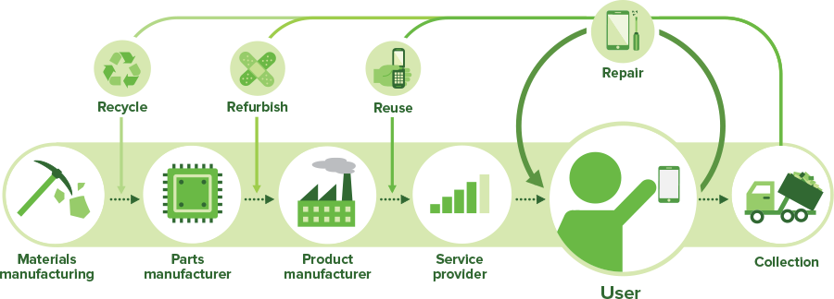
Reduce, reuse, remake, recycle
Circularity makes good sense!

Slide 2
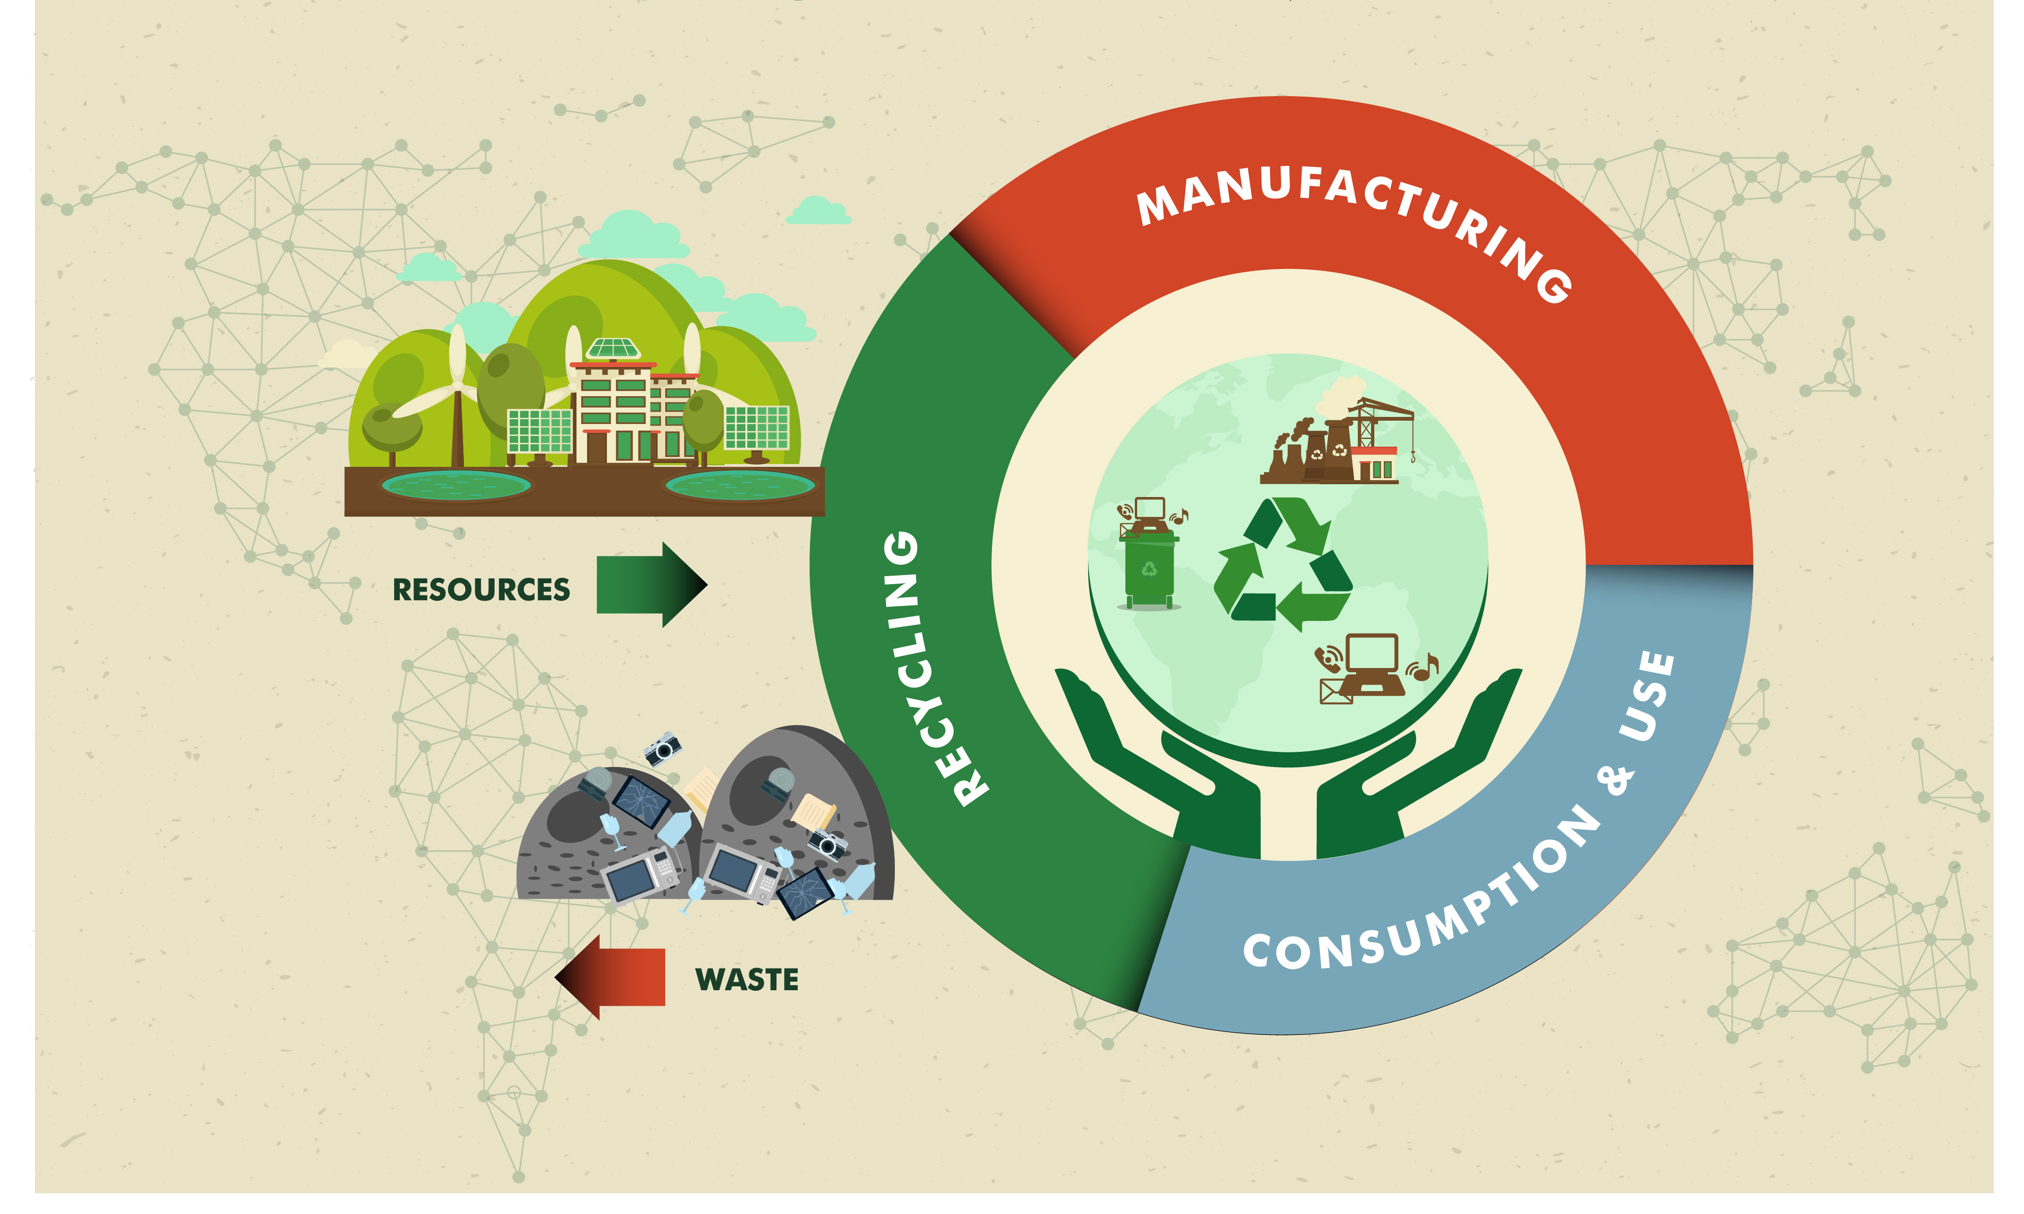
Our Agenda
The Why
The What
The How
The When

Slide 3
Our ancestors –
  Built homes, tore out the things they could reuse
  Burned the rest
  Collected the nails from the ashes to use them for new construction
  It was efficient, effective, and productive
Some Background

Slide 4
Growth
The population grew and the need for more went up
Towns and cities didn’t want people burning their homes
They created dumps
Homes would be torn down and the materials would be hauled to a dump and burned

Slide 5
Mass Production
Henry Ford built cars better than anyone else
Other industries saw this as a boon for them
They mass produced
We didn’t need the nails from the old house and the beams were only good for decoration
Suburbia!
The dumps grew
Take, Make, and Toss!
Notes:
Natural resources are we growing more? Are they inexhaustible? WWI – WWII? GI Bill?

Slide 6
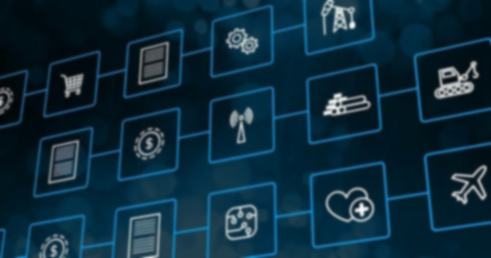
The shift from artisan craft
Automobiles
Homes
Factories
Office Buildings
Strip Malls
Drive Thrus
Moved us to more volume with better quality
With shorter life spans

Slide 7
Reusing Space
Renovating downtowns
Creating Malls away from City Center
Spreading, Tearing Down, and Building Up
The old was moved to landfill operations (aka – Dumps)

Slide 8
Today’s Market
We need more housing in single family dwellings
On miniscule tracts of land
We Tear Out, Remodel, and Flip
We have dumpsters that collect the Torn Out material and efficiently move it to the Landfill where it joins the inner appointments from used autos, “old computers,” and packaging materials

Slide 9
Reduce!
We have made waste handling more efficient, but not more effective.
How do we collect the nails to reuse them?
One example – Using aqueous solvents to replace oil based solvents

Slide 10
We have begun to create awareness
Notes:
Fabrics for clothing, reprocess for new plastic bags

Slide 11
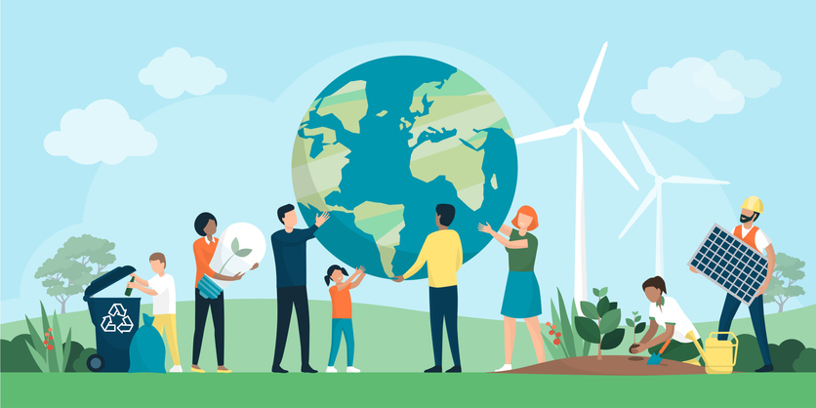
Awareness
Al Gore’s name on a movie about climate change
Scoffing – ridicule – resistance
Remember –
  Paper Drives
  Picking up empty bottles and returning them for the deposit
  Still doing that in your state

Slide 12
Dave’s Goal
Dave Williams owned IPC
It is now Freudenberg-NOK
Molding custom parts out of rubber, steel, and silicone
The waste went to dumps
Why not burn it? EPA – smell – etc.
Today – it gets processed into pellets and gets blended with fuel oil to provide heat to the molds
The electricity is provided by the company’s own hydroelectric generators

Slide 13
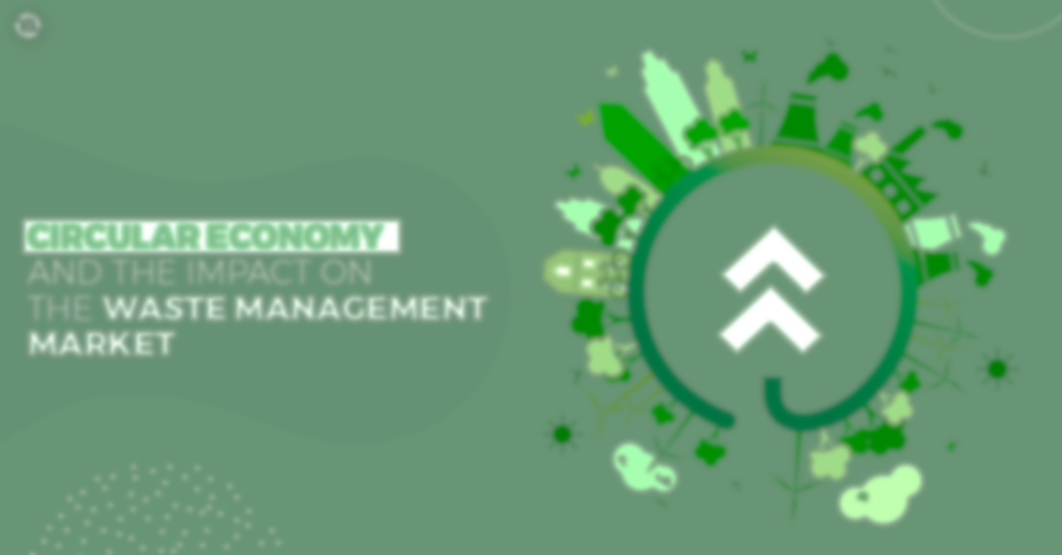
One of our largest waste streams at about 90 million tons per year
  ~50 million tons get recycled*
  ~08 million tons get burned for energy
  ~32 million tons go to landfills
Plastic
Packaging
Notes:
Reduce it!

Slide 14
CAVEAT!!!
~1,000,000 tons of plastic waste gets shipped out of the U.S. to Asian countries for “reprocessing.”
157,000 TEU per year.
China has stopped taking our trash.
Vietnam, India, Bangladesh, and others are taking it, but it is not being recycled.

Slide 15
In a few states, you pay a deposit on many containers and their recycle rate is higher than that in TX.
Pepsico and Anheuser Busch and others are using a new packaging process that uses recycled plastic
  Tops and bottles are the same material
  Return to the store for refund
It’s another step toward circularity!
Deposits as incentives

Slide 16
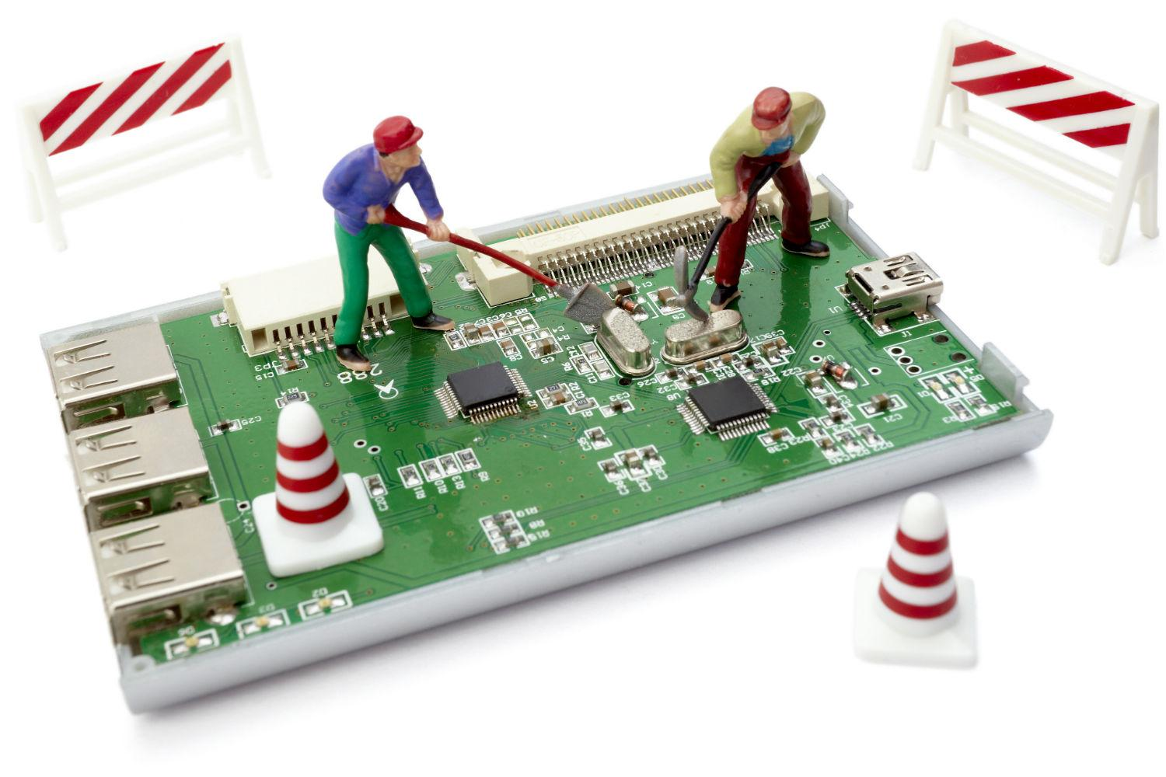
Refurbish or Reman
Cable boxes and cell phones
Diesel Engines, transmissions, fuel pumps, injectors, etc.
Buildings and bridges (see dumps above)
Furniture
Taxis
Notes:
Cat and Cummins competition

Slide 17
Not new, but getting newer
The first papers on Circularity were written in the early 1960’s
They were further developed in the 1980’s as we got serious about pollution.
Notes:
Pemi river cleaning started in 1968. Today it is pure

Slide 18
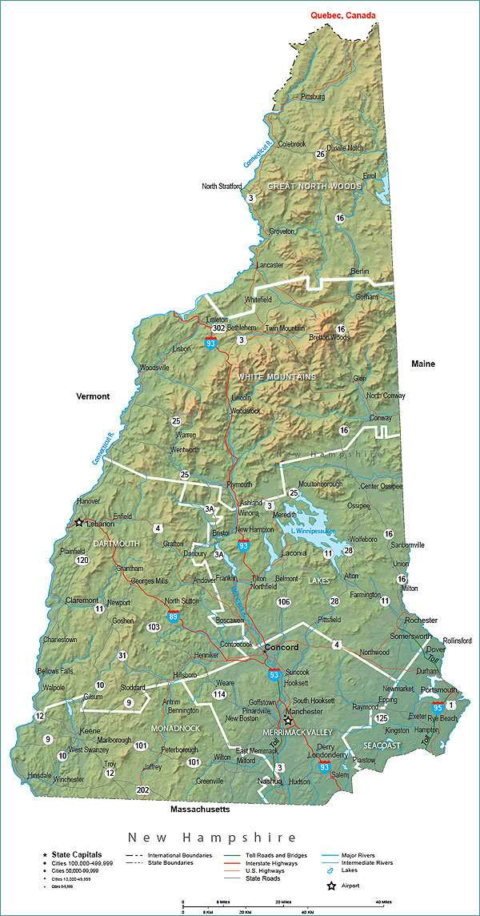
Good News!

Slide 19
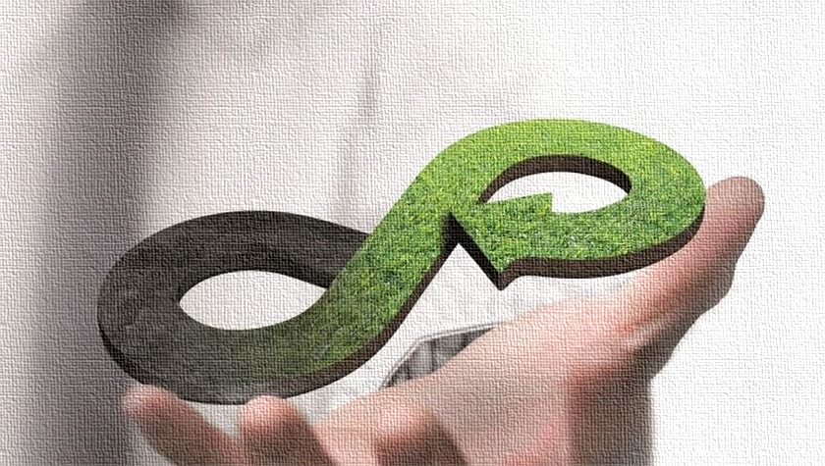
Developing mass reuse and reprocessing to grow from artisan to big business
Finding alternatives to petroleum-based products
Creating a new social scheme that will allow for sustainability
Keys to Improvement

Slide 20
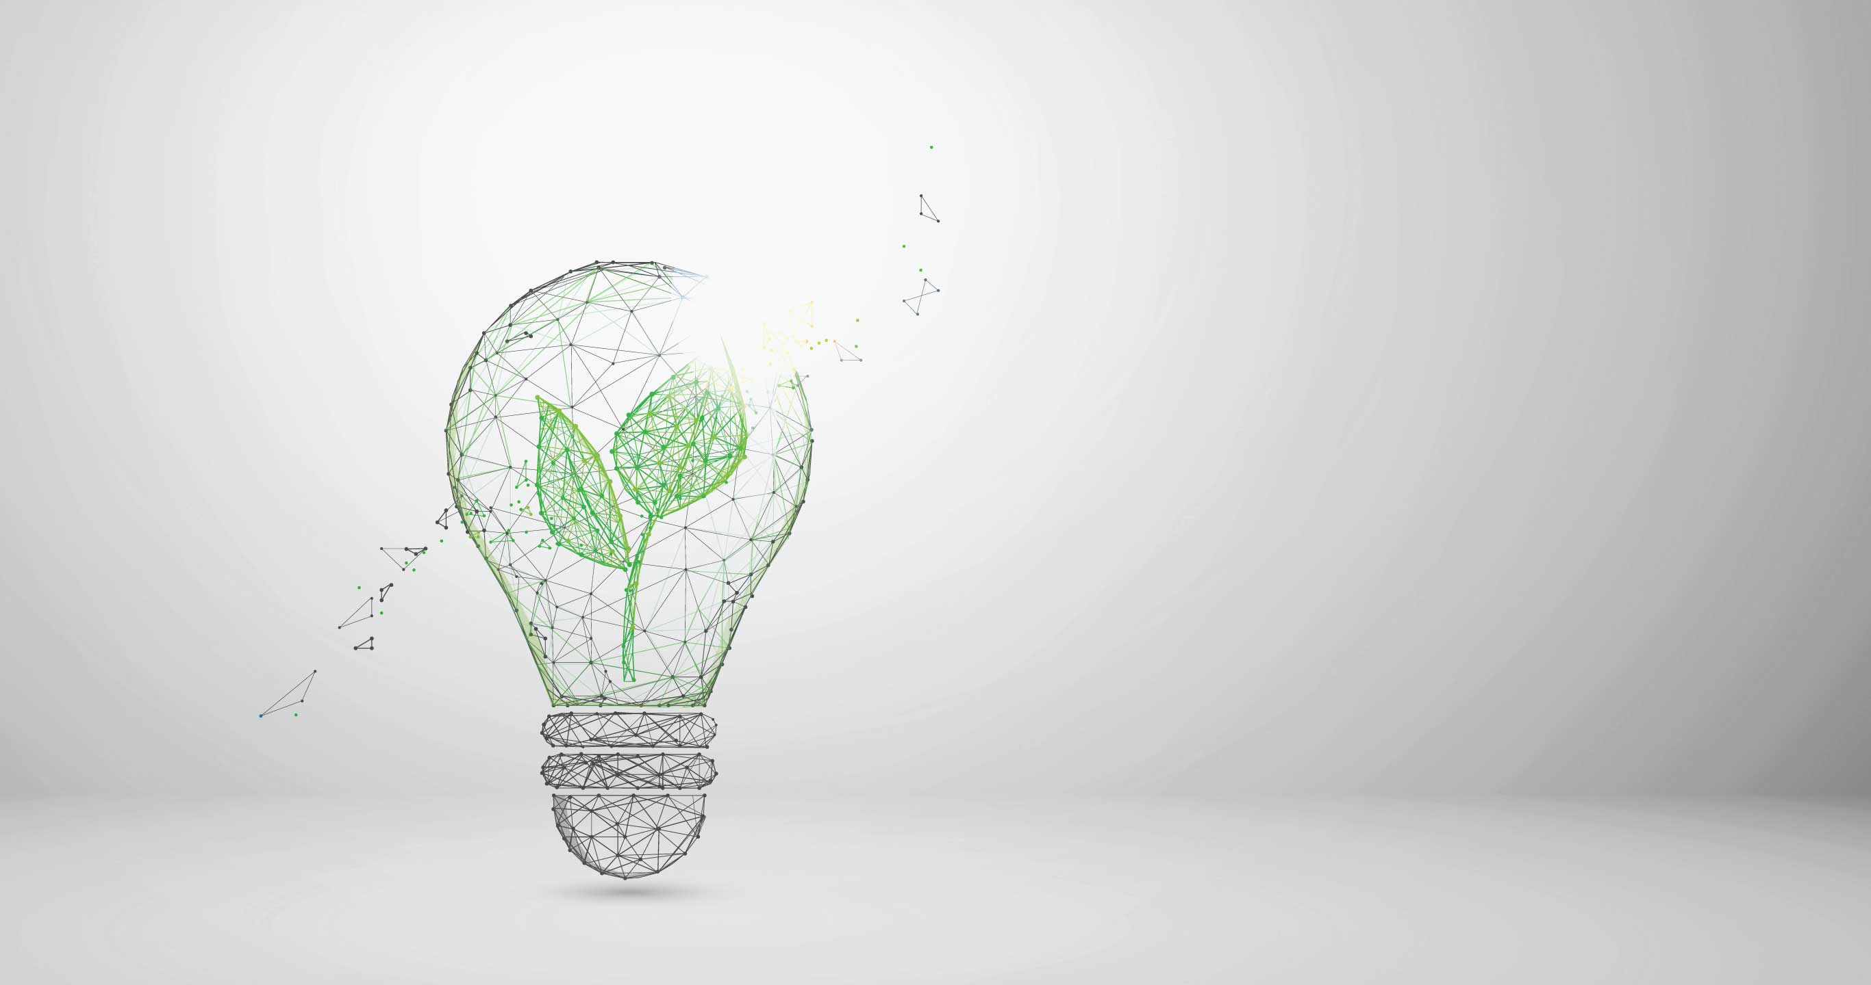
Thank you!
Chet Frame, CPSM, CLTD, CPIM, CSCP cframe@bbcintl.com

